Slide 1

Lecture #7
Digital Image Processing
Frequency Filtering
1st Semester
2019-2020
Dr. Abdulhusein Mohsin Abdulah
Computer Science Dept., CS & IT College, Basrah Univ.

Slide 2
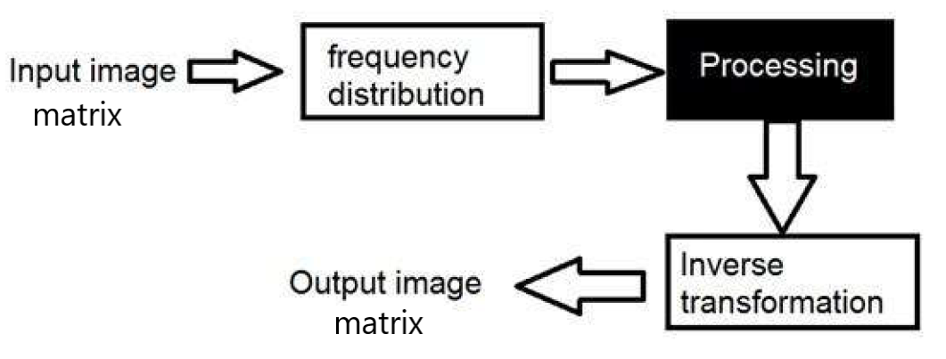
Spatial Domain
Frequency Domain

Slide 3
Transformation
A signal can be converted from time domain into frequency domain using mathematical operators caled
transforms. There are many kind of transformation that does this.. Some of them are given below.
Fourier Series
Fourier Transformation
Z Transformation
Wavelet Transformation

Slide 4
Frequency components
  Any image in spatial domain can be represented in a frequency domain. But what do this frequencies actually mean.
  We will divide frequency components into two major components.
  High frequency components
    High frequency components correspond to edges in an image.
  Low frequency components
    Low frequency components in an image correspond to smooth regions.

Slide 5
Difference between Fourier series and transform
Although both Fourier series and Fourier transform are given by Fourier , but the difference between them is:
Fourier series is applied on periodic signals
Fourier transform is applied for non periodic signals.

Slide 6
Which one is applied on images
Images are non – periodic. And since the images are non periodic, so
Fourier transform is used to convert them into frequency domain.

Slide 7
Discrete Fourier transform
Since we are dealing with images, and in fact digital images, so for digital images we will be working on discrete Fourier transform (DFT)

Slide 8
Consider the following Fourier term of a sinusoid.
it include three things.
Spatial Frequency
Magnitude
Phase

Slide 9
The spatial frequency directly relates with the brightness of the image.
The magnitude of the sinusoid directly relates with the contrast
Contrast is the difference between maximum and minimum pixel intensity.
The Phase contains the color information.

Slide 10

The equation for a 2-D Discrete Fourier Transform is:
Image
The Inverse Discrete Fourier Transform

Slide 11
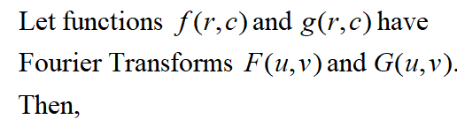

Convolution Property of the Fourier Transform
f(x, y) * h(x, y) F(u, v) H(u, v)
f(x, y) h(x, y) F(u, v)*H(u, v)
h(x, y) H(u, v)
The Fourier Transform of a convolution equals the product of the Fourier Transforms.
Similarly, the Fourier Transform of a convolution is the product of the Fourier Transforms
* = convolution
· = multiplication

Slide 12
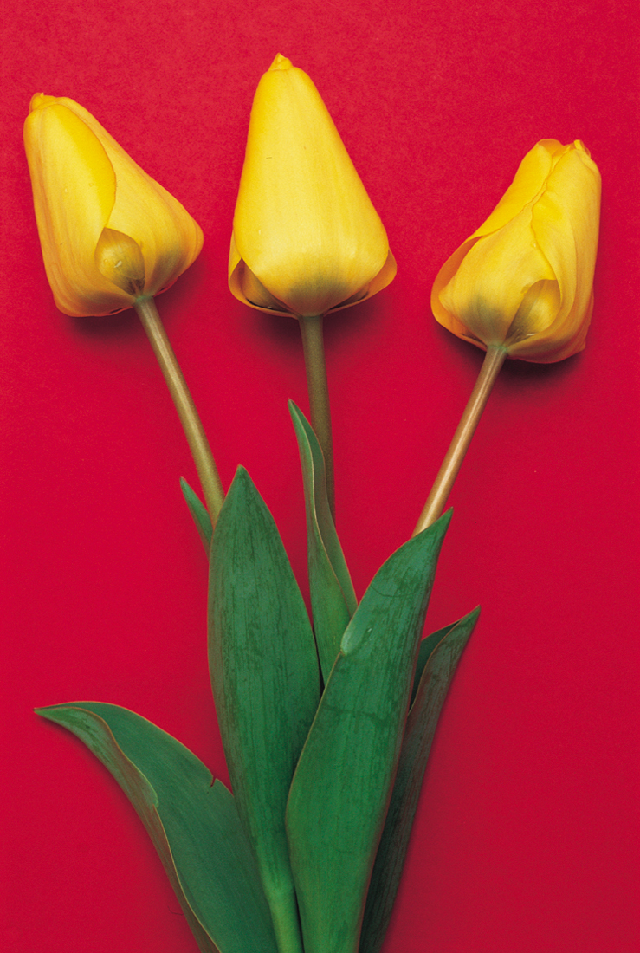
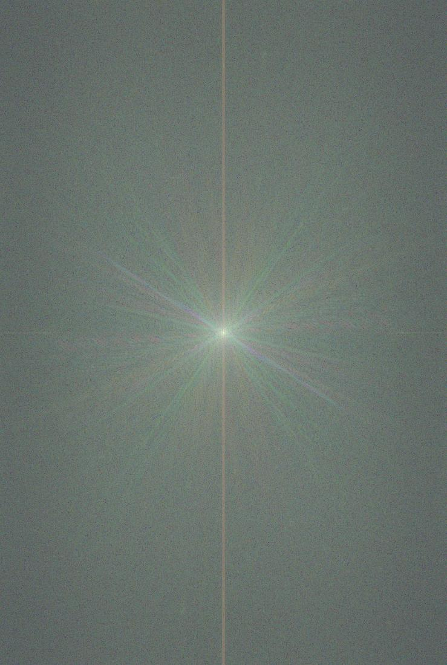
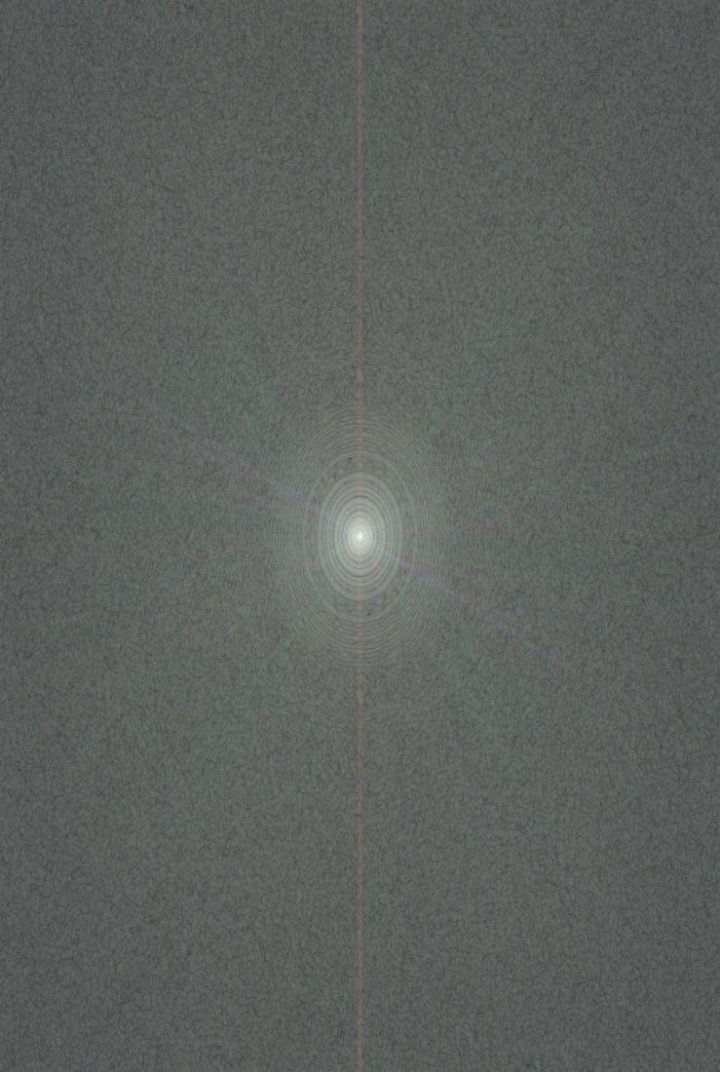

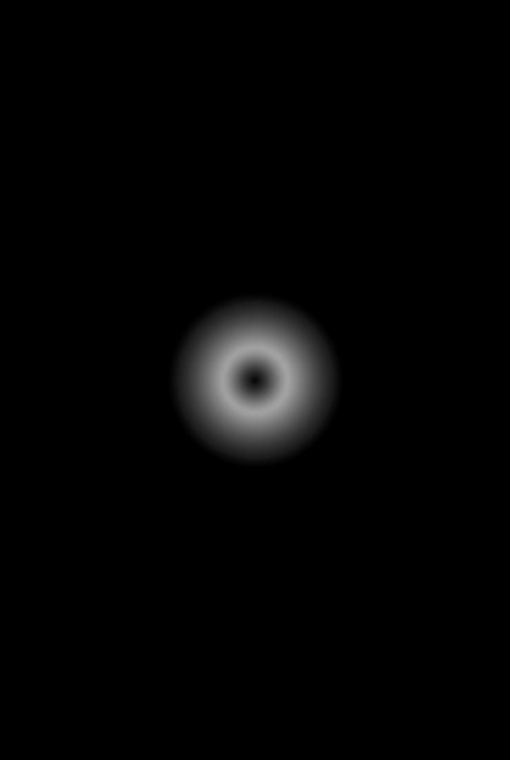
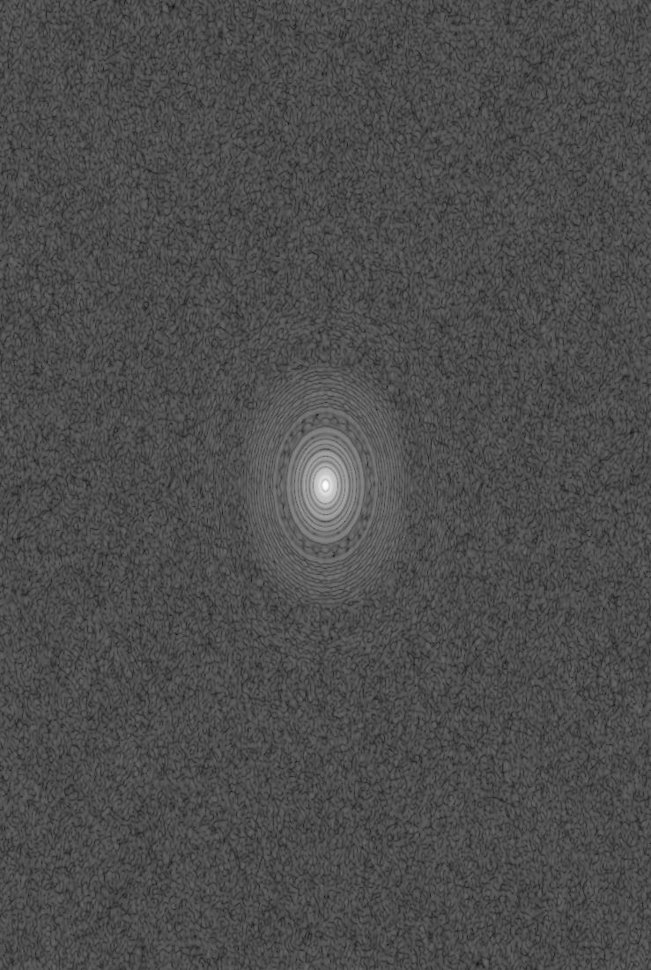
Convolution via Fourier Transform
Image & Mask
Transforms
Pixel-wise Product
Inverse Transform

Slide 13
Filtering in frequency Domain
Fourier Transform
Filtering H(u,v)
Inverse Fourier Transform
Pre-processing
Post-processing
f(x, y)
F(u, v)
H(u, v)F(u, v)
g(x, y)
Image
Enhanced Image

Slide 14
Frequency Domain Filtering
Steps of filtering in the frequency domain
  Calculate the DFT of the image f
  Generate a frequency domain filter H
    H and F should have the same size
    H should NOT be centered. Centered H is for displaying purpose only.
    If H is centered, F needs to be centered too and some post-processing is required (textbook pp158-159)
  Multiply F by H (element by element)
  Take the real part of the IDFT

Slide 15
Steps of filtering
Do some pre – processing an image in spatial domain, means increase its contrast or brightness.
Take DFT of image.
Shift the DFT from to the corners to the center.
Apply filtering, means we will multiply the Fourier transform by a filter function H(u,v).
Shift the DFT from center to the corners.
take to IDFT, to bring the result back from
frequency domain to spatial domain
Post processing is optional, just like pre processing , in which we just increase the appearance of image.

Slide 16
Types of Filters
Ideal HighPass Filter.
Ideal LowPass Filter.
Gaussian HighPass Filter.
Gaussian LowPass Filter.

Slide 17


Ideal Lowpass Filters
Non-separable
>> [f1,f2] = freqspace(256,'meshgrid');
>> H = zeros(256,256); d = sqrt(f1.^2 + f2.^2) < 0.5;
>> H(d) = 1;
>> figure; imshow(H);
Separable
>> [f1,f2] = freqspace(256,'meshgrid');
>> H = zeros(256,256); d = abs(f1)<0.5 & abs(f2)<0.5;
>> H(d) = 1;
>> figure; imshow(H);

Slide 18
Ideal lowpass filters (ILPF)
  Cut off all high-frequency components of the Fourier transform that are at a distance greater than a specified distance D₀ (cut off frequency) from the origin of the (centered) transform
  The transfer function (frequency domain filter) is defined by
  D(u,v) is the distance from point (u,v) to the origin (center) of the frequency domain filter
  Usually, the image to be filtered is even-sized, in this case, the center of the filter is (M/2,N/2). Then the distance D(u,v) can be obtained by

Slide 19
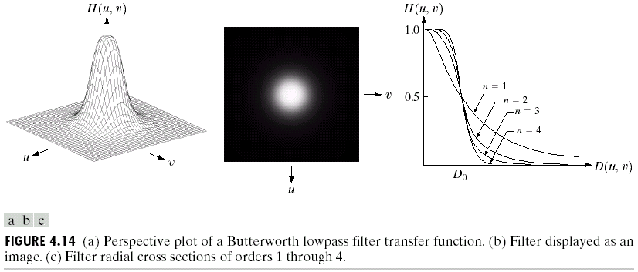
Butterworth Lowpass Filter
As order increases the frequency response approaches ideal LPF

Slide 20
Butterworth Lowpass Filters
A butterworth lowpass filter (BLPF) of order n with cutoff frequency at a distance D₀ from the origin is given by the following transfer function
  BLPF does not have a sharp discontinuity
  For BLPF, the cutoff frequency is defined as the frequency at which the transfer function has value which is half of the maximum

Slide 21
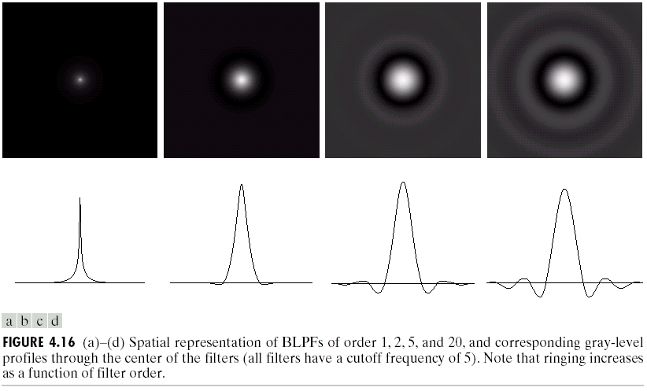
Butterworth Lowpass Filter
Approach to a sinc function.

Slide 22
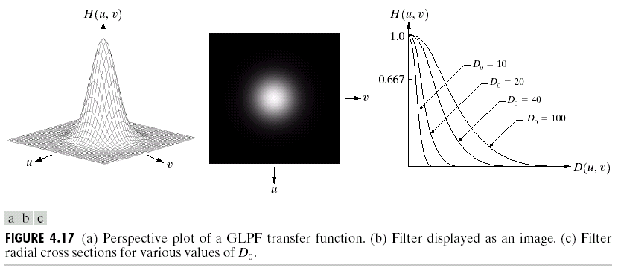
Gaussian Lowpass Filter

Slide 23
Gaussian Lowpass Filters
GLPF is given by the following (centered ) transfer function
  (u₀,v₀) is the center of the transfer function
  It is [M/2, N/2] if M,N are even and [(M+1)/2,(N+1)/2] if M,N are odd numbers
  Dose GLPF suffer from the ringing effect?

Slide 24
Homework
Let g(x)=cos(2πfx), x=0,0.01,0.02,…0.99
  Plot the signal g(x)
  Plot the spectrum of g(x) for f=1, 5, 10, 20
  Plot the centered spectrum
  Plot the signal g’(x) whose spectrum is the centered spectrum of g(x)
  Plot the spectrum of g₂(x)=1+g(x)
  How do we get g(x) from g₂(x) using frequency domain filtering?

